Slide 1
Leveraging Retriever-Reader Architecture for Enhanced Review-Based Question-Answering
Artificial Intelligence Project
Mario Avolio 880995

Slide 2
Initial Informations and GitHub Repository
In this presentation, I will delve into the construction of a Review-Based Question Answering (QA) System using a Retriever-Reader Architecture. The technical intricacies of the process will be explored, with a focus on the utilization of Haystack, an open-source Python framework developed by deepset. Haystack empowers me to seamlessly integrate state-of-the-art language models into my NLP applications.
The focus will be on the synergy between the Retriever and Reader components within the architecture. I will elucidate how these components work in tandem to form a coherent QA pipeline. The capabilities of Haystack's Document Store and Pipeline will also be showcased, emphasizing their role in effective document management and system efficiency.
Evaluation is a cornerstone of my project. I will discuss how metrics like recall provide insights into the retriever and reader's individual performance.
To delve into the practical implementation, I will provide a link to my GitHub repository AI-Project, where detailed technical information about the project can be found.

Slide 3
Table of contents
Key Aspects Explored: SubjQA Dataset, Span Classification and Sliding Window Technique
Constructing a Question-Answering Pipeline Using the Retriever-Reader Architecture
Document Store Selection: Leveraging Elasticsearch for Efficient Data Storage
Sparse Retrieval: Utilizing BM25 for Effective Document Retrieval
Reader Component: Enhancing Answer Extraction with DistilRoBERTa-base
Assessment and Enhancement of the QA Pipeline
Retriever Evaluation: Comparative Analysis of DPR and BM25 with Recall Measure
Reader Enhancement: Comparing Fine-Tune and Domain Adaptation Models with EM and F1-Score
Overall QA Pipeline Evaluation: Measuring Performance Impact of Retriever on Reader
Advancing with Generative QA: Retrieval-Augmented Generation (RAG)
RAG Overview: Introducing Retrieval-Augmented Generation as an Abstractive QA Approach
Challenges of RAG: Limitations and Considerations
Solution: The PromptNode Approach with T5 and BM25

Slide 4

01
Key Aspects Explored
SubjQA Dataset, Span Classification and Sliding Window Technique

Slide 5
SubjQA Dataset
SubjQA is an English Question-Answering dataset centered around customer reviews.
It comprises subjective annotations for questions and answer spans.
The dataset encompasses 6 distinct domains: TripAdvisor, Restaurants, Movies, Books, Electronics, and Grocery.
E.g. “What is the best and worst film in the Star Wars saga?”
The user's preferences dictate the nature of the query.
Crucial elements of the query remain absent from the review, rendering it unsuitable for simple solutions such as keyword searches or paraphrasing of the input question.
J. Bjerva et al., “SubjQA: A Dataset for Subjectivity and Review Comprehension”, (2020).

Slide 6
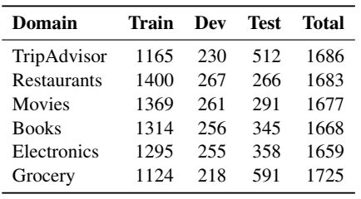
SubjQA Dataset
SubjQA is unique as it focuses on understanding subjectivity in reviews, unlike previous QA datasets.
For our project, we'll specifically build a QA system for the Movies domain, aligning with our targeted use case.
J. Bjerva et al., “SubjQA: A Dataset for Subjectivity and Review Comprehension”, (2020).

Slide 7
SubjQA Dataset
Column | Description
title | ASIN associated with each product
question | The question
answers.answer_text | The span of text in the review labeled by the annotator
answers.answer_start | The start character index of the answer span
context | The customer review
J. Bjerva et al., “SubjQA: A Dataset for Subjectivity and Review Comprehension”, (2020).

Slide 8

SubjQA Dataset: Analysis
title | question | answers.text | answers.answer_start | context
630428845X | How is the story? | [] | [] | This has got to be one of the most boring and tedious movies I have EVER seen, not just out of the Halloween films. …
630575067X | How is character? | ['the digital characters'] | [1071] | Like most Star Wars fans, I literally counted down the days until this was released. Then, on opening day, I saw it. And all the magic I experienced as a kid was gone…
J. Bjerva et al., “SubjQA: A Dataset for Subjectivity and Review Comprehension”, (2020).

Slide 9
SubjQA Dataset: Analysis
Observations from the examples:
Questions exhibit common grammatical errors, akin to FAQ sections on e-commerce sites.
"answers.text" absence signifies "unanswerable" questions, lacking relevant review-based answers.
Example of Context in SubjQA Dataset:
“Like most Star Wars fans, I literally counted down the days until this was released. Then, on opening day, I saw it. And all the magic I experienced as a kid was gone. Sure it has great visual fx, but my God! The story was horrible! The Trade Federation is blockading the planet of Naboo? Huh?! What the hell does that mean? How many kids are going to understand that? At least in the original trilogy the story was easy to comprehend. An evil empire. A big, bad Death Star that can destroy entire planets. A princess that needs rescuing. It was simple, but it worked. With this new trilogy, George Lucas seemed to think that computer fx was all he needed to make a great movie. The story, obviously was secondary. As was the acting. I swear, there were times I literally cringed when certain dialogue was spoken. Ok, enough of that. It did have a few good things to offer us "old fans", but not enough to give this even a 3 star rating. Here is where I think the film succeeded and where it failed.The good:1) The visual fx. Wow. The film sure looks good. The vehicles, the digital characters. It sure makes the fx in the first trilogy look antique.2) The pod race. Holy crap! The was ten times more exciting than the speeder bike race in "Return of the Jedi".3) Darth Maul. Need I say more?4) The lightsaber battles. Finally we get to see what the Jedi (and the Sith) are really capable of.5) The origin of C-3PO. So, Vader/Anakin made him huh? Cool!6) R2-D2. As usual, he pulls everybody's fat out of the fire.Now, the bad:1) The acting. Ugh! Awful. It looks as if everybody learned their lines five minutes before they went in front of the camera. Natalie Portman is especially bad here. Sorry, but it's true. Her acting is horrible.2) Yoda. While it's great to see the old Jedi Master again, he doesn't look like the Yoda we remember. He looks...well, I'm not sure. But does have fat lips. And a strange head.3) The story. As stated earlier, it's too confusing and many times just makes no sense. Why would the Trade Federation blockade Naboo of all planets…”
J. Bjerva et al., “SubjQA: A Dataset for Subjectivity and Review Comprehension”, (2020).

Slide 10
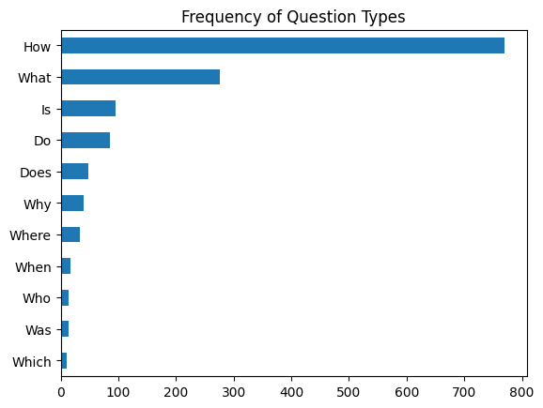
SubjQA Dataset: Analysis
Prevalent question types identified:
Questions starting with "How," "What," and "Is" are the most common:
"How is the story line?"
"How is the music?"
"How can I read the set story at this hotel?"
"What is the price of the DVD?"
"What is the really things?"
J. Bjerva et al., “SubjQA: A Dataset for Subjectivity and Review Comprehension”, (2020).

Slide 11
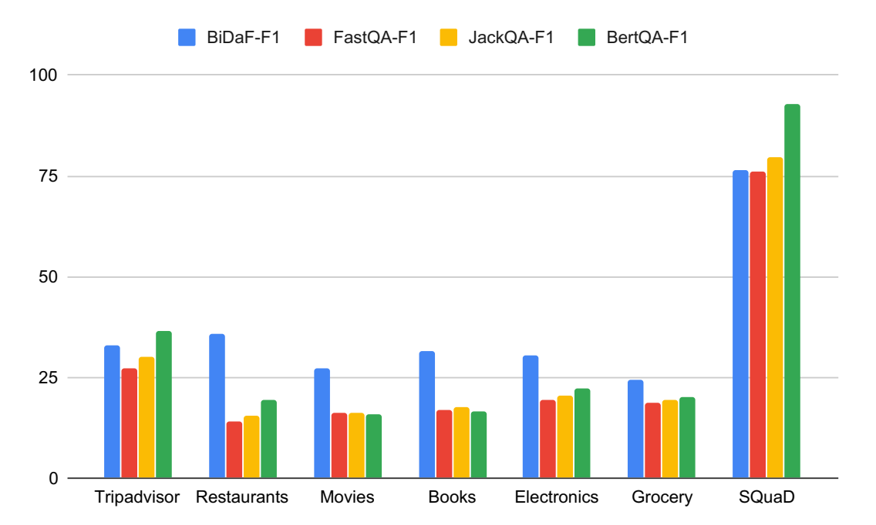
SubjQA Dataset: Baselines
Pre-trained models' performance:
Achieve up to 92.9% F1 score on SQuAD dataset.
Contrastingly, the best model scores an average F1 of 30.5% across all domains and 36.5% F1 at best within any specific domain in SUBJQA.
J. Bjerva et al., “SubjQA: A Dataset for Subjectivity and Review Comprehension”, (2020).

Slide 12
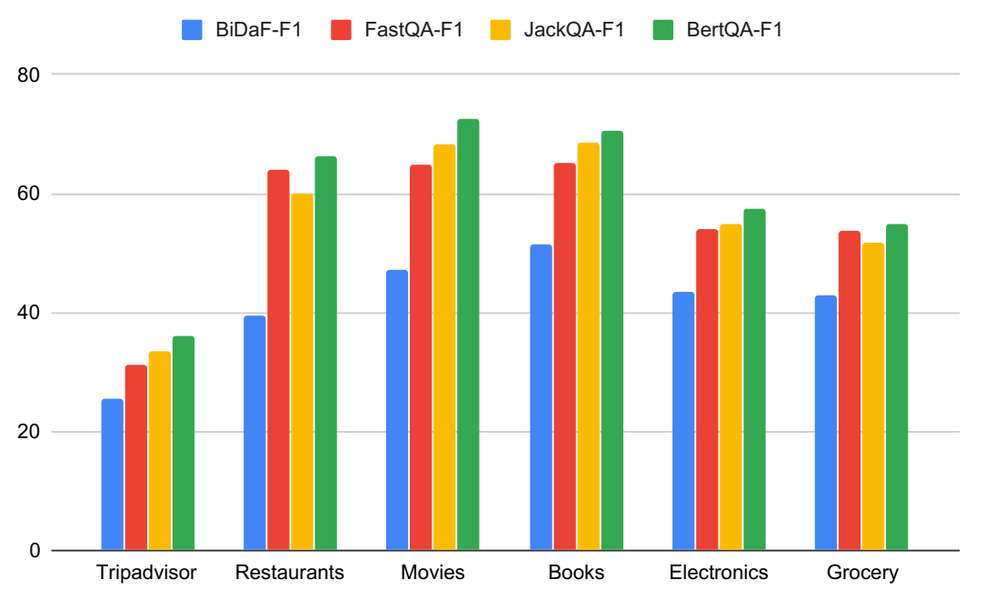
SubjQA Dataset: Baselines
Enhanced F1 Scores with Domain-Specific Fine-Tuning:
Models fine-tuned on specific domains show improved F1 scores.
Best model achieves an average F1 of 74.1% across diverse domains.
Fine-tuning significantly boosts F1 scores in each domain.
F1 scores, however, remain lower compared to SQuAD dataset.
Subjectivity's Impact on Performance:
Models lack awareness of subjective expressions in questions and reviews.
Agnostic nature contributes to the performance gap.
Multi-Task Learning with Domain Knowledge:
Fine-tuning over each domain using Multi-Task Learning (MTL).
Subjectivity-aware model emerges.
Achieves average F1 of 76.3% across various domains.
J. Bjerva et al., “SubjQA: A Dataset for Subjectivity and Review Comprehension”, (2020).

Slide 13
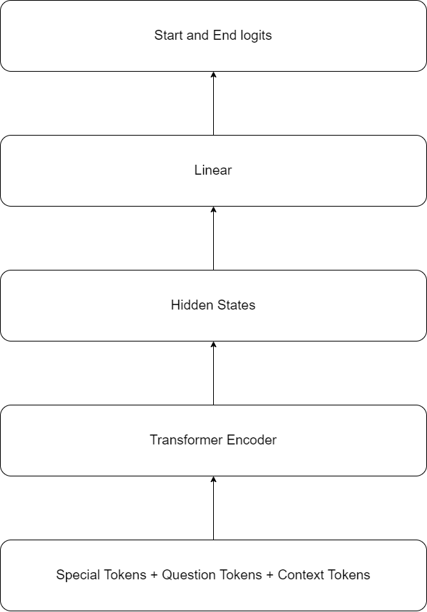
Span classification
Initial Requirement for QA System Development:
First step: Establish method for identifying potential answer spans within customer reviews.
Prevalent Approach for Answer Extraction:
Frame problem as span classification task.
Model predicts start and end tokens of answer span as labels.
Labels indicate answer's position within the text.

Slide 14
Span Classification Utilizing Pre-Trained Models
Given the situation where our training set is relatively small with only 1369 examples, starting with a language model that has already been fine-tuned on a large-scale QA dataset like SQuAD is indeed a sound strategy. These pre-trained models generally possess strong reading comprehension capabilities and serve as a solid baseline for building a more accurate QA system.
As for selecting a specific extractive QA model from the Hugging Face Hub, we should consider various factors:
Language: If our corpus is monolingual (e.g., English), we should focus on models fine-tuned for that specific language. If we are dealing with multilingual data, consider using a multilingual QA model that can handle multiple languages.
Size and Efficiency: Larger models often provide better performance, but they may require more computational resources and have longer inference times. We need to consider the trade-off between model size and efficiency, especially when deploying the model in a production environment.
Task-Specific Performance: We should evaluate the performance of different models on our specific extractive QA task using metrics like accuracy, F1 score, or other relevant metrics.
Compatibility with Task Domain: Check if the model has been fine-tuned on domains similar to our Movies QA use case. A model fine-tuned on a domain closer to our target domain may perform better.
Availability of Resources: Ensure that we have access to the necessary computational resources (GPU, memory) to run the chosen model effectively.
Complete list of possible models here

Slide 15
Span Classification Utilizing Pre-Trained Models
Transformer | Number of Parameters | F1-score on SQuAD 2.0
roberta-base-squad2-distilled | 124M | 83.92
xlm-roberta-large-squad2 | 560M | 83.79
tinyroberta-squad2 | 81.5M | 81.92
Info: https://huggingface.co/deepset/roberta-base-squad2-distilled

Slide 16
Span Classification: Input Features and Predicted Outputs
Extractive QA Inputs:
Presented as (question, context) pairs.
Both components are tokenized using the tokenizer.
Model Instantiation and QA Head:
Instantiate model with QA head, including linear layer.
Linear layer takes hidden states from the encoder.
Computes logits for start and end spans.
Forward Pass and Logits Generation:
Model generates two sets of logits for each token.
Logits correspond to start and end of answer span.
Larger, positive logits indicate higher confidence.
Identifying Answer Spans:
Logits represent likelihood of tokens as span candidates.
Comparing logits helps find probable start and end tokens.
Final answer span is extracted based on these tokens.

Slide 17
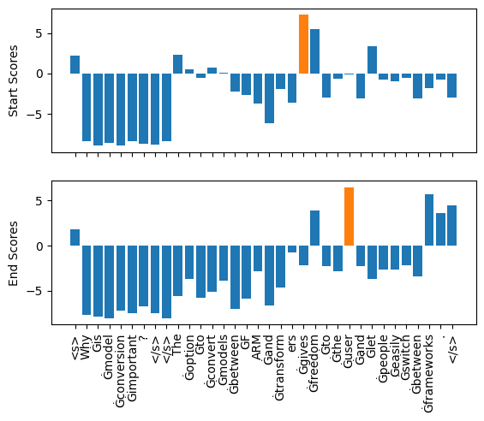
Span Classification: Input Features and Predicted Outputs
Question: "Why is model conversion important?"
Context: "The option to convert models between FARM and transformers gives freedom to the user and let people easily switch between frameworks."
Answer: “gives freedom to the user”

Slide 18
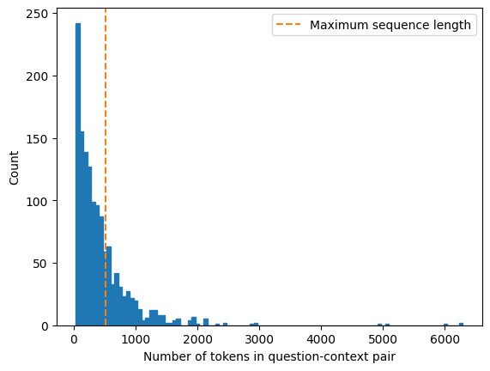
Strategies for Long Passage Handling in Span Classification
Challenge of Context Length:
Reading comprehension models have a maximum sequence length.
Context (passage) often exceeds this limit, causing issues.
SubjQA question-context pairs may not fit within this limit.
DistilRoBERTa-base has a context size of 512 tokens.
Sliding Window Technique:
Solution: Utilize a sliding window approach.
Break oversized context into smaller windows or passages.
Each window fits within the model's context size.
Windows can overlap to ensure coverage of information.

Slide 19
Strategies for Long Passage Handling in Span Classification
The sliding window technique works as follows:
Dividing Context: The context is divided into smaller overlapping windows of suitable length.
Context Overlap: To ensure that the model does not miss crucial information, the windows typically overlap. This means that some tokens are present in multiple windows.
Independent Inference: Each window is treated as an independent passage during inference. The model runs inference on each passage separately to obtain potential answers.
Combining Answers: If an answer spans multiple windows, the final answer is determined by combining the results from all relevant passages.
<s>How did you like the movie?</s></s>Well, I have to admit I wasn't expecting to like this movie, having read all the bad press surrounding it. But I saw it last night on a whim and I have to say I thought it was fantastic! Firstly, as a movie it is incredibly well shot. The scenery is wonderful and the sets are painstakingly recreated never once do you doubt this is 1st century Palestine.The acting starts off a little…</s>
<s>How did you like the movie?</s></s> sets are painstakingly recreated never once do you doubt this is 1st century Palestine.The acting starts off a little strained in the garden scene, when the movie is just finding it's feet (and the audience is coming to terms with the fact that the movie isn't some horrible, cheap propaganda short, but a proper movie) but quickly becomes impressive and ends up brutally real.Gibson has set out to make a compelling dram…</s>
<s>How did you like the movie?</s></s> a proper movie) but quickly becomes impressive and ends up brutally real.Gibson has set out to make a …</s>

Slide 20
02
Constructing a Question-Answering Pipeline Using the Retriever-Reader Architecture
Efficient Document Retrieval and Answer Extraction

Slide 21
Retriever-Reader Architecture
Building a Comprehensive QA Pipeline:
Beyond answer extraction, QA pipelines need additional components.
Real-world user queries require selecting relevant passages from reviews.
Adopting a retriever-reader architecture is a common approach.
Key Components: Retriever and Reader:
Retriever: Responsible for retrieving relevant documents based on queries.
Reader: Extracts answers from documents provided by the retriever.
Retriever-Reader Architecture Synergy:
Retriever narrows down the search space by identifying relevant passages.
Reader then extracts precise answers from the selected passages.
End-to-End QA Solution:
Combination of Retriever and Reader forms a comprehensive QA pipeline.
User's question leads to passage retrieval by the Retriever.
Relevant passages are handed to the Reader for accurate answer extraction.

Slide 22
Retriever-Reader Architecture: Details
Retriever:
Retrieves relevant documents for a given query.
Categorized as sparse or dense retrievers.
Sparse Retriever:
Represents documents and queries using word frequencies.
Relevance determined by inner product of sparse vectors.
Dense Retriever:
Utilizes transformer-based encoders (e.g., BERT).
Generates contextualized embeddings for queries and documents.
Captures semantic meaning for nuanced search accuracy.
Reader:
Extracts answers from retriever's provided documents.
Typically a reading comprehension model.
Predicts start and end positions of answer span.

Slide 23
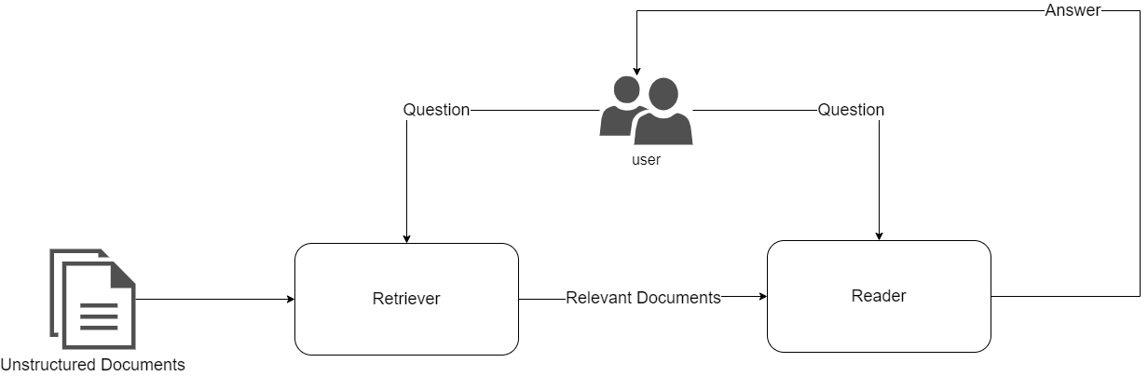
Retriever-Reader Architecture: The Structure

Slide 24
Haystack Library
Utilizing Haystack for QA System Development:
Haystack is a library developed by deepset, a German NLP company.
Offers an efficient way to build QA systems based on the retriever-reader architecture (in this case).
Simplifies complexities and integrates seamlessly with Transformers.
Components of the Haystack Framework:
Document Store: A database storing documents and metadata for retriever queries.
Efficiently manages documents and metadata.
Provides documents to the Retriever during queries.
Pipeline: Central component combining all aspects of the QA system.
Handles custom query flows and combinations of retrievers.
Enables flexible and complex QA configurations.
Haystack's Role in QA System Development:
Facilitates end-to-end QA pipeline creation.
Streamlines processes from document storage to answer provision.
Empowers developers to build sophisticated QA systems with ease.
Info: https://haystack.deepset.ai/

Slide 25
Haystack Library: the Document Store
Document Stores in Haystack:
Diverse options, each matched with specific retrievers.
Choice aligned with our project's focus on both sparse and dense retrievers.
ElasticsearchDocumentStore Selection:
Chosen for compatibility with both retriever types.
Based on Elasticsearch, a versatile search engine.
Elasticsearch's Strengths:
Handles various data types, including text, numbers, geospatial info, and more.
Efficiently manages large data volumes with rapid full-text search capabilities.
Info: https://www.elastic.co/elasticsearch/

Slide 26
Haystack Library: the Document Store
Functionality of ElasticsearchDocumentStore:
Automatically creates two indices on Elasticsearch.
"document" index for storing documents like SubjQA reviews.
"label" index for storing annotated answer spans.
Utilization of Document Store:
"document" index populated with SubjQA reviews for retrieval.
Leveraging Fields for Filtering:
ElasticsearchDocumentStore provides filter-applying fields.
Inclusion of "title" and "id" (question id) columns from SubjQA dataset.
Facilitates document filtering based on product and question IDs
Info: https://www.elastic.co/elasticsearch/

Slide 27
Haystack Library: the Document Store
 | InMemory | Elasticsearch | OpenSearch | SQL | Milvus | Weaviate | Pinecone | Qdrant | FAISS
BM25 | Y | Y | Y | N | N | Y | N | N | N
TF-IDF | Y | Y | Y | Y | N | Y | Y | N | N
Embedding | Y | Y | Y | N | Y | Y | Y | Y | Y
Multihop | Y | Y | Y | N | Y | Y | Y | Y | Y
DPR | Y | Y | Y | N | Y | Y | Y | Y | Y
Filter | Y | Y | Y | Y | Y | Y | Y | Y | Y
MultiModal | Y | Y | Y | Y | Y | Y | Y | Y | Y
WebRetriever | Y | Y | Y | Y | Y | Y | Y | Y | Y
Info: https://docs.haystack.deepset.ai/docs/retriever

Slide 28
Haystack Library: the Retriever
Utilizing Sparse Retriever with BM25:
BM25 (Best Match 25) algorithm selected for our review-based QA system.
BM25 enhances classic TF-IDF (Term Frequency-Inverse Document Frequency).
BM25's Sparse Vector Approach:
Represents question and context as sparse vectors.
Efficiently enables searches on Elasticsearch.
The BM25 Scoring Mechanism:
Measures relevance of matched text to search query.
Improves over TF-IDF by normalizing document length and saturating TF values..
Targeted Retrieval with "Title" Column:
Crucial to focus on reviews for specific products.
Use the "title" column containing ASIN (Amazon Standard Identification Number).
Ensures retriever sources reviews pertinent to the queried product.

Slide 29
Haystack Library: the Retriever
Item_id (title): "630575067X" (Star Wars Episode I, The Phantom Menace VHS)
Query: "Who is Anakin Skywalker?
{"content": "I recently received my copy of the Phantom Menace DVD and am quite pleased with it. I must say that the sound quality of the DVD is really quite amazing. The sound and picture quality and special effects alone are worth the price of the DVD.Despite the strengths of the special effects, I must say that the script and the acting are extremely weak at times during the movie. For example, little 5-year-old Anakin Skywalker hits on the Princess at many times during the movie. Those scenes are extremely unrealistic. I just find it really hard to believe that little brat would flirt that much with the adult princess.Also, Anakin Skywalker simply cannot act. That boy basically reads his lines without much emotion. I think that the little kid from the 6th Sense would have played a much better Anakin Skywalker.What genius decided that it would be a good idea to have JarJar Binks in almost every scene? I do understand that JarJar is supposed to provide comic relief. However, JarJar is not funny at all he's just really annoying.And what's the deal with the Jedi blood test? Why could they do this at the time of the first episode, but not at any time during episodes 4-6? Was the technology simply lost? It doesn't make any sense to me.However, despite the script and acting weaknesses, the film is still much better than most of the movies churned out by Hollywood today.", "content_type": "text", "score": 0.8190174837486695, "meta": {"item_id": "630575067X", "question_id": "fd98baf7a7c7493345a8b7a829a1cc31", "split": "train"}, "id_hash_keys": ["content"], "embedding": null, "id": "0a73d8520d625b481c751a872ba78863"}

Slide 30
Haystack Library: the Reader
Utilizing Reader Component for Answer Extraction:
Employing the reader to extract answers from retrieved documents.
Utilizing FARMReader based on deepset's FARM framework.
Compatibility with transformer-based models and Transformers-trained models.
Simplified Model Loading:
FARMReader can load models directly from Hugging Face Hub.
Streamlines the setup process and model integration.
Sliding Window Mechanism:
Sliding window behavior controlled by "max_seq_length" and "doc_stride" parameters.
Similar parameters were seen for the tokenizer.
Efficiently handles long contexts by breaking them into overlapping windows.
DistilRoBERTa-base with FARMReader:
Using DistilRoBERTa-base model trained on SQuAD 2.0.
"max_seq_length" set to 384 for processing context windows.
Sliding window mechanism divides context into overlapping segments.
Accurate Answer Extraction:
FARMReader processes windows to extract relevant information.
Combines results from each segment to provide precise answers.
Info: https://farm.deepset.ai/

Slide 31
Haystack Library: the Pipeline
Pipeline Abstraction in Haystack:
Allows creation of “flexible graphs” combining retrievers, readers, and more.
Customizable for specific use cases.
Predefined pipelines tailored for QA systems.
ExtractiveQAPipeline for Answer Extraction:
Utilizing ExtractiveQAPipeline for answer extraction.
Requires a retriever-reader pair as input arguments.
Simple Configuration for Answer Extraction:
Input query, number of documents to retrieve and number of answers to extract
Applying Filters for Precision:
Utilizing the "filters" argument to restrict queries to a specific item ID.
Similar to the item ID filter used in the retriever.
Example:
Question: “Who is Anakin Skywalker?”
Answer 1: “little 5-year-old”
Review snippet: ...acting are extremely weak at times during the movie. For example, little 5-year-old Anakin Skywalker hits on the Princess at many times during the mo...
Answer 2: “Darth Vader”
Review snippet: ...nto motion. We see the young Anakin Skywalker, who's fate is the evil Darth Vader, but who will eventually bring balance to the Force.Surely these thi...
Answer 3:
Review snippet: ...None...
Info: https://docs.haystack.deepset.ai/docs/pipelines & https://docs.haystack.deepset.ai/docs/ready_made_pipelines

Slide 32
03
Assessment and Enhancement of the QA Pipeline
Retriever-Reader Enhancement for Improved QA Performance

Slide 33
Evaluation Procedures
Importance of Performance Evaluation:
Recognizing varying degrees of relevance in extracted answers.
Need to enhance system's performance by quantifying retriever and reader capabilities.
Balance Between Reader and Retriever:
Reader's performance relies on retriever's accuracy in document retrieval.
Retriever establishes upper limit for overall QA system performance.
Focus on Retriever's Proficiency:
Retriever's role in effective document retrieval is paramount.
Ensuring retriever's accuracy is vital for successful QA outcomes.
Introduction of Evaluation Metrics:
Introducing standard evaluation metrics to assess retriever's performance.
Facilitates comparison between sparse and dense representations.
Implication for System Enhancement:
Evaluation metrics serve as foundation for improving system's components.
Offers insights into optimizing retriever-reader dynamics for better outcomes.

Slide 34
Assessing the Retrieval Component
Evaluating Retriever Performance:
Recall metric commonly used for retriever performance evaluation.
Recall measures the proportion of relevant documents retrieved.
"Relevant" signifies answer presence within text passage.
Compute recall by counting answer appearances in top k retriever documents.
Haystack's DocumentSearchPipeline:
Utilize "DocumentSearchPipeline" in Haystack for evaluation.
Establishes framework for evaluating retriever's effectiveness.
Adding Answers to Label Index:
Populate dedicated label index in ElasticsearchDocumentStore.
Haystack's Label object represents answer spans and metadata.
Create Label objects by iterating over test set questions.
Extract matching answers and relevant metadata for each question.
Enhancing Label Metadata:
Each Label contains query-answer pair and associated data.
Include product ID in meta field for label filtering.
Mapping for Aggregation:
Establish mapping between question IDs and answers.
Facilitates grouping of answers by related questions.
Enables comprehensive and organized evaluation process.
Info: https://haystack.deepset.ai/tutorials/11_pipelines#fetching-and-writing-documents

Slide 35
Assessing the Retrieval Component
Label Example:
<Label: {'id': 'ad6d57c9-5e58-4284-843d-9004fe07a4cb', 'query': 'How is the visuals of the film?', 'document': {'id': '12c6b2914cfd01209da7c8cc4a35920f', 'content': "My, and I believe nearly everyone's favourite &quot;Star Wars&quot;-movie is Episode V-&quot;The Empire Strikes Back&quot;. Not only because it was visually the most dazzling, it also had far more sense of wonder and magic than the other Episodes. Never had a &quot;Star Wars&quot;-film a greater emotional impact.&quot;The Phantom Menace&quot; is definetly not on par with that film, nor has it the originality of &quot;A New Hope&quot;, but still I liked this film a lot. I actually found it better than &quot;Return Of The Jedi&quot;. Even those who dispised the movie must acknowledge that it has its merits. The special effects are fantastic, and in contrast to other films with superior FX, they are also highly imaginative because they create entire worlds of their own. Individual action-setpieces are among the most exhilarating of the decade (the pod-race or the final lightsaber-duel among others) and John William's score is one of the major assets again.Many complained that Jar Jar Binks is too silly and childish…;.", 'content_type': 'text', 'meta': {}, 'id_hash_keys': ['content'], 'score': None, 'embedding': None}, 'is_correct_answer': True, 'is_correct_document': True, 'origin': 'gold-label', 'answer': {'answer': 'Wars&quot;-film a greater emotional impact.&quot;The Phantom Menace&quot; is definetly not on par with that film, nor has it the originality of &quot;A New Hope&quot;, but still I liked this film a lot. I actually found it better than &quot;Return Of The Jedi&quot;. Even those who dispised the movie must acknowledge that it has its merits. The special effects are fantastic, and in contrast to other films with superior FX', 'type': 'extractive', 'score': None, 'context': None, 'offsets_in_document': None, 'offsets_in_context': None, 'document_ids': None, 'meta': {}}, 'pipeline_id': None, 'created_at': '2023-08-03 14:55:39', 'updated_at': None, 'meta': {'item_id': '630575067X', 'question_id': 'c2fda2a4bb1c00124a9a00f9b1741348'}, 'filters': {'item_id': ['630575067X'], 'split': ['test']}}>
Info: https://haystack.deepset.ai/tutorials/11_pipelines#fetching-and-writing-documents

Slide 36
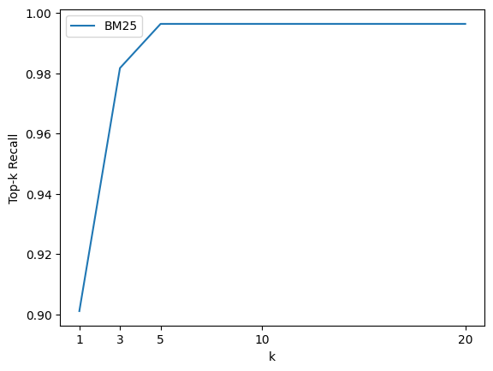
Assessing the Retrieval Component
Retriever Evaluation Process:
Evaluate retriever by inputting question-answer pairs into pipeline.
Track correct retrievals using the pipeline object (DocumentSearchPipeline).
Adjustable parameter "k" controls number of retriever documents.
Impact of "k" on Performance:
Increasing "k" enhances recall by retrieving more relevant documents.
Trade-off: More documents to reader may slow down pipeline.
Optimal "k" Selection:
Create function to iterate over various "k" values.
Compute recall across entire test set for each "k" value.
Analyze recall trend for different "k" values and plot results.
Observation and Analysis:
Plot may exhibit inflection point around "k = 3".
Beyond this point, recall gains may diminish.
Near-perfect recall achieved from "k = 5" onwards.

Slide 37
Assessment of the Retriever: Leveraging Dense Passage Retrieval (DPR)
Introducing Dense Passage Retrieval (DPR):
Aims to enhance retrieval with fewer documents for the reader.
Addresses limitations of sparse retrievers like BM25.
Improves efficiency and accuracy of document retrieval.
Benefits of Dense Embeddings:
Utilizes dense embeddings for question and document.
Employs two BERT models as encoders.
Maps input text to d-dimensional [CLS] token vector.
Facilitates efficient comparison and similarity computation.
Advantages Over Sparse Retrievers:
Sparse retrievers struggle with non-matching query terms.
DPR's dense embeddings enable effective retrieval.
Especially useful when sparse retriever's documents are insufficient.
Role of DPR in QA Pipeline:
Enhances QA pipeline's document retrieval process.
Increases efficiency by passing fewer documents to reader.
Expands retrieval capabilities in scenarios with diverse query terms.
V. Karpukhin et al., “Dense Passage Retrieval for Open-Domain Question Answering”, (2020).

Slide 38
Assessment of the Retriever: Leveraging Dense Passage Retrieval (DPR)
Consider the question: "Who is the bad guy in Lord of the Rings?" which can be answered from the context: "Sala Baker is best known for portraying the villain Sauron in the Lord of the Rings trilogy."
A term-based retrieval system would face challenges in retrieving such a context due to the mismatch between the terms "bad guy" and "villain." In contrast, a dense retrieval system excels by capturing the semantic meaning behind words. It can recognize the association between "bad guy" and "villain," allowing it to accurately match the query with the relevant context. As a result, the dense retrieval system can fetch the correct context that provides the answer.
V. Karpukhin et al., “Dense Passage Retrieval for Open-Domain Question Answering”, (2020).

Slide 39
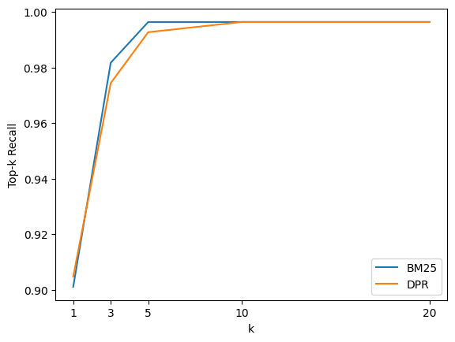
Assessment of the Retriever: Leveraging Dense Passage Retrieval (DPR)
Leveraging Fine-Tuned Encoders:
Encoders fine-tuned on NQ corpus.
Aim to capture higher similarity for relevant question-passage pairs.
Enhances the retrieval process.
Updating Embedding Representation:
Iterate through indexed documents in Elasticsearch.
Apply encoders to update embedding representations.
Prepare documents for efficient retrieval.
Evaluation of Dense Retriever:
Assess dense retriever using top-k recall comparison.
Similar evaluation approach to BM25.
Measure recall improvement over different k values.
Recall Comparison: DPR vs. BM25:
Evaluate whether DPR improves recall.
Observe if dense embeddings enhance retrieval.
It appears that the Dense Passage Retrieval (DPR) approach does not yield improved results in this context.
Potential Performance Enhancements:
Consider using FAISS library for faster similarity search.
Fine-tuning DPR retriever on target domain.
Aims to optimize the retriever's performance.
V. Karpukhin et al., “Dense Passage Retrieval for Open-Domain Question Answering”, (2020).

Slide 40
Reader Evaluation Metrics: Assessing Performance
Key Metrics for Reader Evaluation:
Exact Match (EM): Binary metric for perfect match of predicted and actual answers.
F1-score: Harmonic mean of precision and recall, balances false positives and negatives.
EM is stricter than F1-score, which considers incorrect answers.
Both metrics are crucial for comprehensive assessment.
Practical Considerations:
EM and F1-score calculated for each question-answer pair.
Best score chosen from possible answers.
Overall EM and F1 scores obtained by averaging individual scores.
Evaluation in Haystack:
Reader evaluation performed through dedicated pipeline.
Single node in the pipeline: the reader itself.
Info: https://docs.haystack.deepset.ai/docs/evaluation#metrics-question-answering

Slide 41
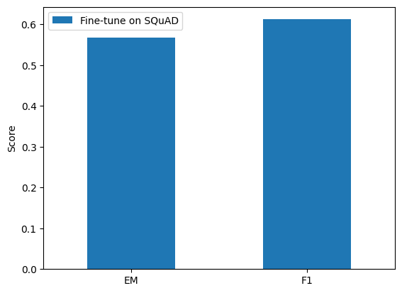
Evaluating Reader Performance: Leveraging Pre-Trained Models
Model Performance Comparison:
"roberta-base-squad2-distilled" model achieves (on SubjQA dataset):
EM: 56.78
F1-score: 61.24.
Notably lower than its performance on SQuAD 2.0:
EM: 79.8
F1-score: 83.92.
Factors Contributing to Performance Gap:
Distinct characteristics of customer reviews in SubjQA:
Informal language.
Differs from structured Wikipedia articles.
Subjectivity within SubjQA dataset:
Both questions and answers are subjective.
Deviates from factual information.
Info: https://huggingface.co/deepset/roberta-base-squad2-distilled

Slide 42
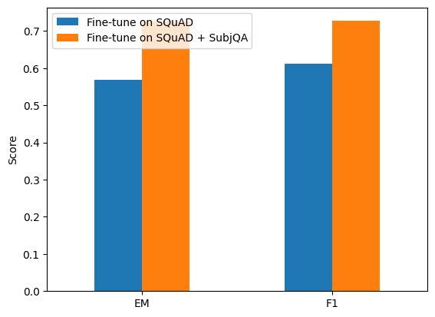
Assessing the Reader: Domain Adaptation Evaluation
Enhancing Model Performance via Fine-Tuning:
SubjQA model performance lagged behind SQuAD despite generalization capabilities.
Common observation: Transformer models tend to overfit SQuAD.
Highlighted by Yogatama et al. (2019): Need to address domain-specific challenges.
The Direct Approach: Domain Adaptation through Fine-Tuning
Solution: Further fine-tuning DistilRoBERTa-base on SubjQA training dataset.
Domain adaptation crucial for improving reader's performance on SubjQA.
Info here
Remarkable Performance Enhancement:
Initial scores on SubjQA:
EM: 56.78
F1: 61.24
After domain adaptation::
EM: 72.53
F1: 72.71
Impressive percentage performance gain:
EM: ~27.75%
F1: ~18.71%.
Yogatama et al. in "Learning and Evaluating General Linguistic Intelligence" (2019)

Slide 43
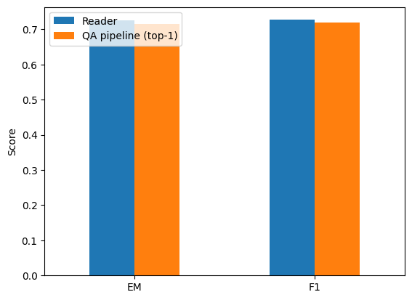
Comprehensive Evaluation of the QA Pipeline
Evaluating the Entire QA Pipeline:
Integrating retriever and reader components for holistic assessment.
Retriever pipeline augmented with nodes for reader and evaluation.
Maintaining k = 5 for comprehensive reader assessment.
Examining reader's performance on multiple contexts per query.
Assessing Retriever-Reader Impact:
Top 1 Exact Match (EM) and F1 scores compared.
Evaluating model's capability to predict answers in retrieved documents.
Insight into retriever's contribution to overall system performance.
Plot reveals minimal degradation compared to SQuAD-style evaluation.

Slide 44
Comprehensive Evaluation of the QA Pipeline
Slight Shift in Performance:
EM and F1 scores undergo a subtle shift.
Transition from 72.53 and 72.71 to 71.43 and 71.92, respectively.
Negligible percentage performance gain: -1.52% for EM and -1.12% for F1.
Underlining the Negligible Reduction:
Notable shift in scores with minimal impact.
K=5 choice in retriever limits documents passed to reader.
Maintains streamlined pipeline efficiency.
Negligible reduction attributed to controlled document quantity.
Potential Mitigation:
Consider expanding scope of reader predictions.
Allowing broader range of answer predictions.

Slide 45
04
Advancing with Generative QA: Retrieval-Augmented Generation (RAG)
Unlocking Potential with PromptNode: Harnessing Large Language Models for NLP

Slide 46
Enhancing Retrieval-Reader Architecture with RAG
Abstractive or Generative QA:
Departure from conventional span-based answer extraction.
Pretrained language models used for answer generation.
Potential for well-phrased and evidence-synthesized answers.
Retrieval-Augmented Generation (RAG):
Modern advancement in QA paradigm.
Enhances classic retriever-reader architecture.
Reader replaced by generator, DPR employed for retrieval.
Generator based on pretrained sequence-to-sequence transformer (e.g., T5, BART).
Latent vectors from DPR used for response generation.
Iterative process leveraging query and documents.
RAGenerator in Haystack
Original RAG Model Variants:
RAG-Sequence:
Uses same retrieved document for complete answer.
Top k documents input to generator.
Output sequence generated for each document.
Aggregated results for optimal answer.
RAG-Token:
Different documents generate individual answer tokens.
Empowers synthesis of evidence from multiple documents.
P. Lewis et al., “Retrieval-Augmented Generation for Knowledge-Intensive NLP Tasks”, (2020).

Slide 47
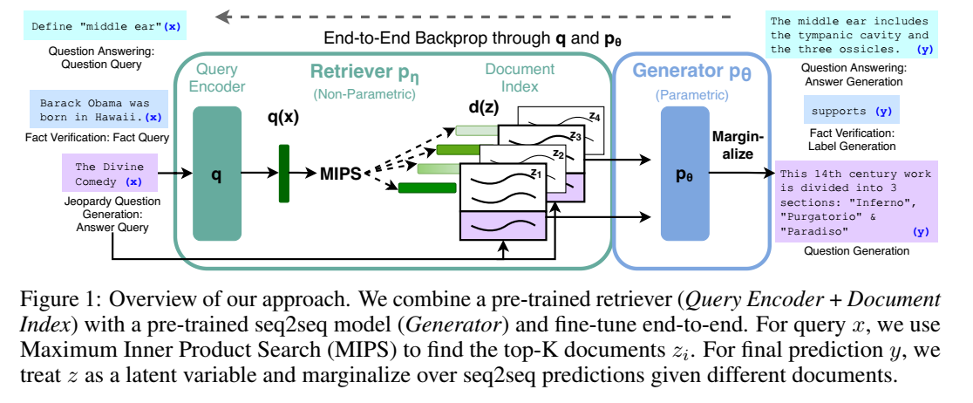
Enhancing Retrieval-Reader Architecture with RAG
P. Lewis et al., “Retrieval-Augmented Generation for Knowledge-Intensive NLP Tasks”, (2020).

Slide 48
Challenges in RAG and the PromptNode Solution
Limited Support for Previous Models:
Suboptimal performance observed in these models.
Outdated and scarce implementations on Hugging Face model repository.
Tightly Coupled with Dense Passage Retrievers (DPR):
Dependency on Dense Passage Retrievers (DPR).
DPR's performance shortcomings, especially out-of-domain, highlighted in studies.
Emerging Approach: Utilizing PromptNode in Haystack
Common practice for Retrieval Augmented Generation.
PromptNode facilitates integration of various language models.
Hugging Face text and text2text-generation models employed.
T5 model (google/flan-t5-large) chosen for generator in this context.
BM25 as Retriever
Thakur, Nandan, et al. "Beir: A heterogenous benchmark for zero-shot evaluation of information retrieval models." (2021)

Slide 49
Challenges in RAG and the PromptNode Solution
Challenge of Contextual Relevance:
Example question: "Who is Anakin Skywalker?"
Response: "The Phantom Menace is a movie that isn't one that the average person is going to memorize, because it isn't simplistic like episodes 4, 5, and 6."
The generated answer seems unrelated and off-topic.
Retrieval-Augmented Generation Challenge:
PromptNode-based approach using T5.
Responses can be contextually related but not directly relevant to the user's query.
Challenges include ensuring accurate and on-topic answers.
Token Size Limitation Issue:
Model "google/flan-t5-large" has a maximum token size of 512.
Documents from BM25 retriever may get truncated when passed to this model.
Solutions to Token Size Issue:
Option 1: Change to a model with a larger window size (e.g., OpenAI models).
Option 2: Adjust PromptNode's max_length parameter.
Improved Answer with Option 2:
Question: "Who is Anakin Skywalker?"
Answer: "The character is a Jedi Knight."
Info: https://docs.haystack.deepset.ai/docs/prompt_node#usage

Slide 50
Directing Focus towards Deprecation within the Haystac Framework
In the Haystack framework, it's important to note that there have been significant updates regarding the RAGenerator component. As of version 1.16, RAGenerator has been deprecated, and subsequently, it has been entirely removed from the framework in version 1.18. To adapt to this change and continue exploring generative QA pipelines, the Haystack team recommends referring to their comprehensive tutorial titled "Creating a Generative QA Pipeline with Retrieval-Augmentation". For more detailed insights into this deprecation and the rationale behind it, we can refer to the official announcement made by the Haystack team on their GitHub repository.

Slide 51
Conclusions

Slide 52

— Edsger Dijkstra
“Computer science is no more about computers than astronomy is about telescopes”

